Slide 1

TechRiot – Prototype Demo
Unified Automation Framework -Web and Mobile
Paarrivanan, Lavanya,
Bala, Sravani
17/1/2022

Slide 2
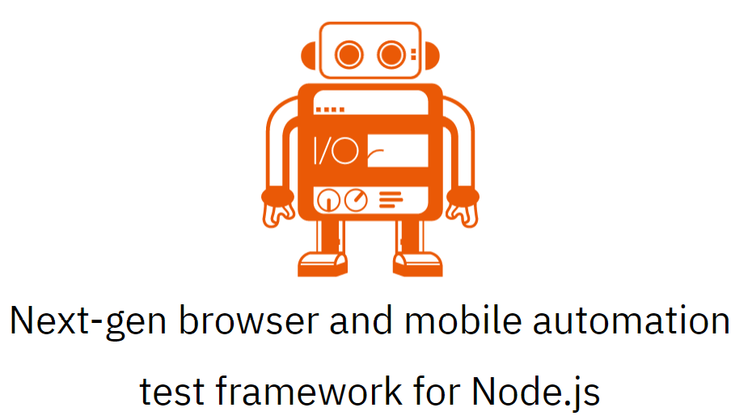

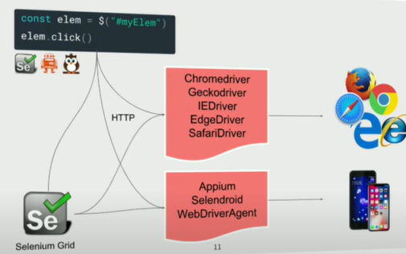

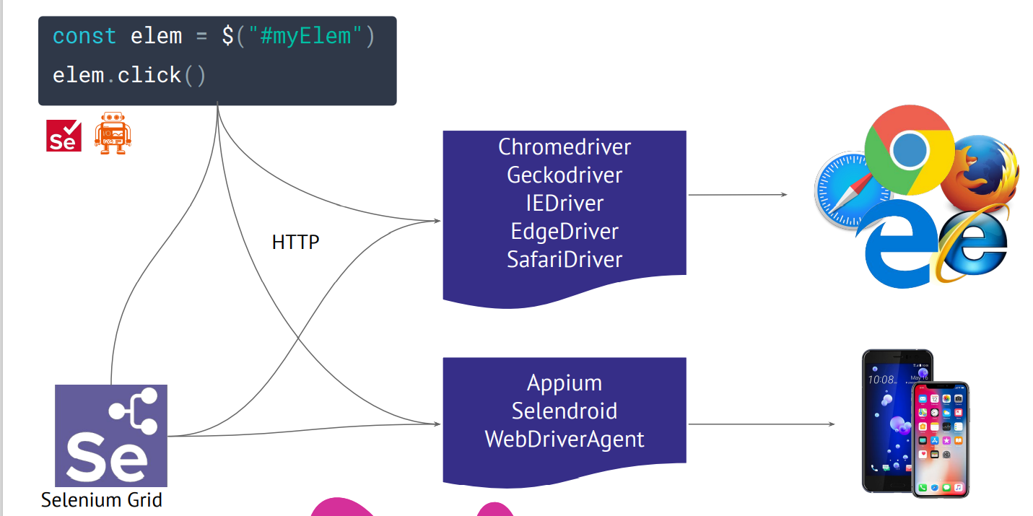
Unified Automation Framework - Solution Proposed
WebdriverIo
JavaScript
Selenium Standalone
Server
Web Browsers
JSON Wire Protocol
Appium Server
IOS/Android Native/Hybrid
Tech Stack Web | Tech Stack Mobile
Tools: Cucumber BDD, JS, Node.js, Allure Reports, VS Code | Tools: Mocha, TS, Node.Js, Android Studio, Appium server, Appium doctor, Allure Reports, VS Code, Junit reports

Slide 3
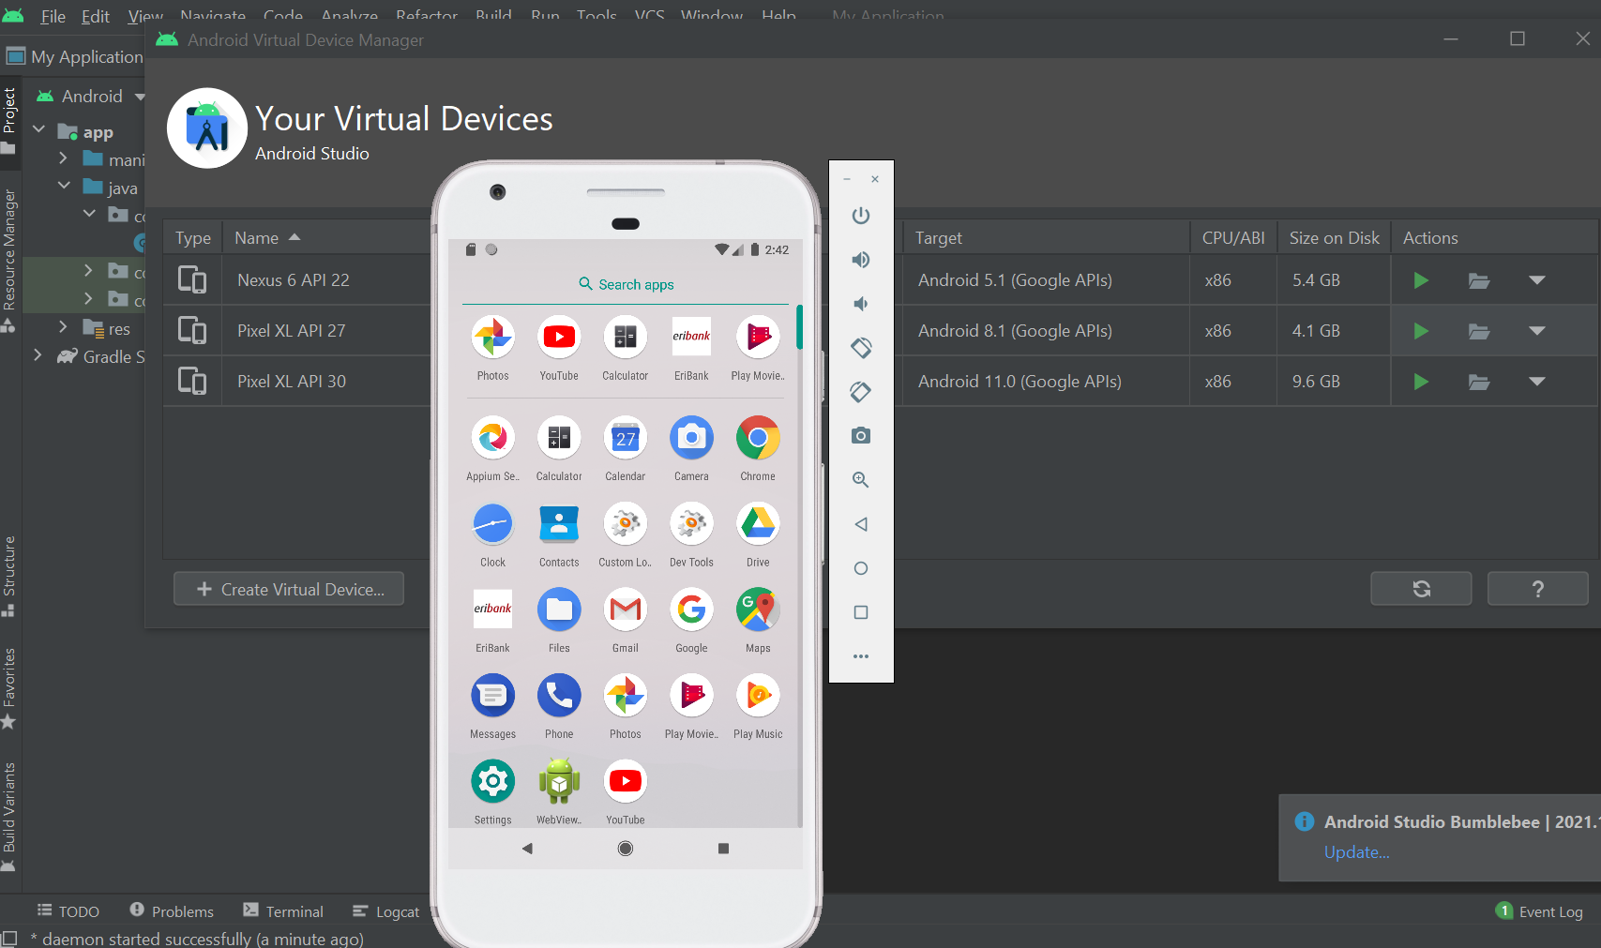

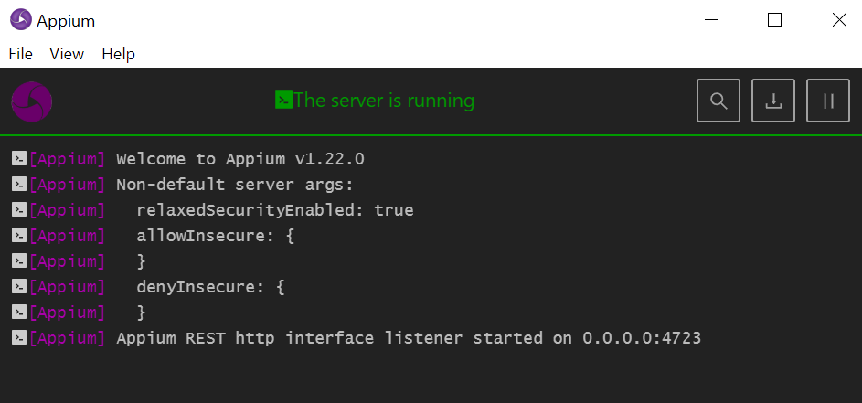
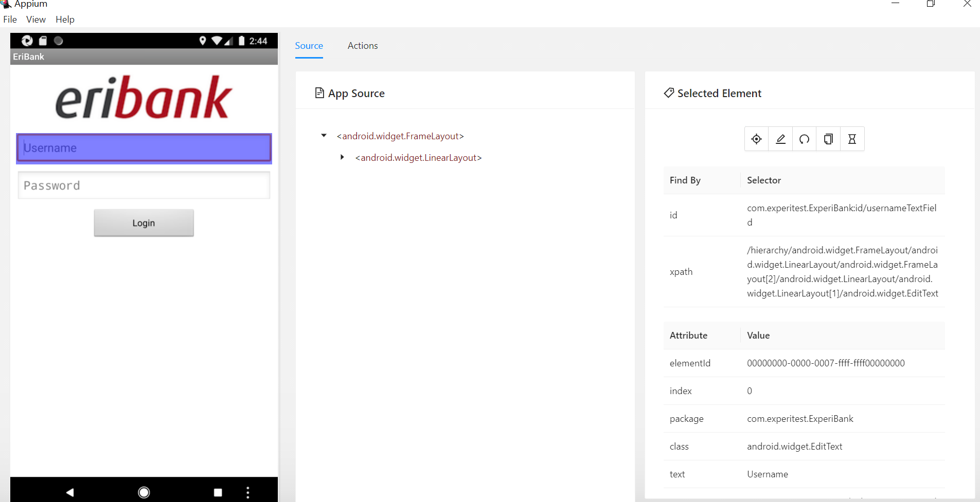
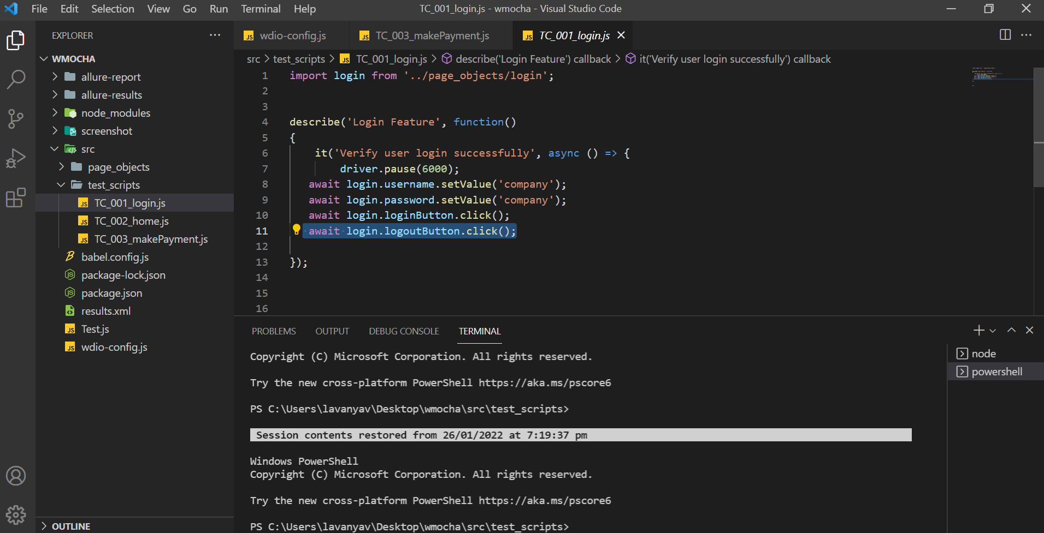
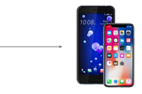


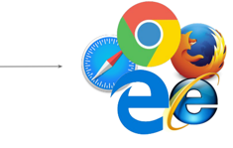
Technical Implementation Flow Diagram
#Android Studio
#Current Pain Points
Case by case execution
No ALM/Jira Integration
Devices allocated are stale
Device fragmentation ignored
Device reservation is not possible
Environment performance is poor
Batch Scheduler not available
Setup and installation time consuming
Tangled Framework
Programming skills heavily required
Execution speed is low
Leveraging allocated Mac/iPad
#Appium Server
#Appium Doctor
#IDE
Frameworks
1.Quantum
2. Selenium C#
3. C# API
4. UFT
5. Tosca
JSON Wire Protocol

Slide 4

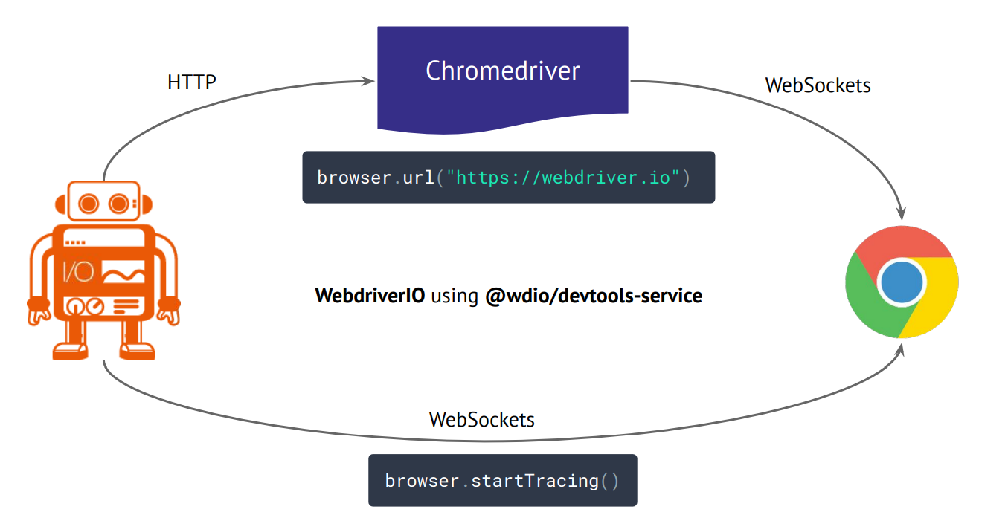
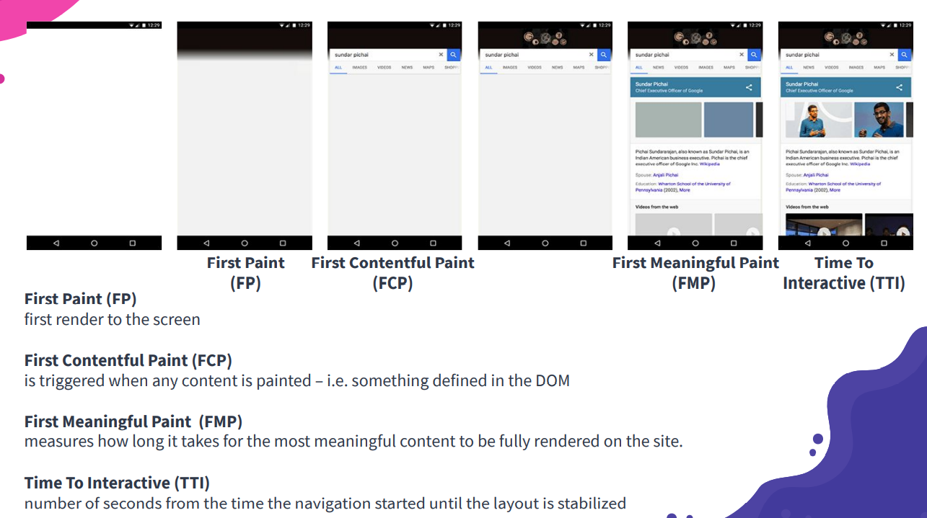
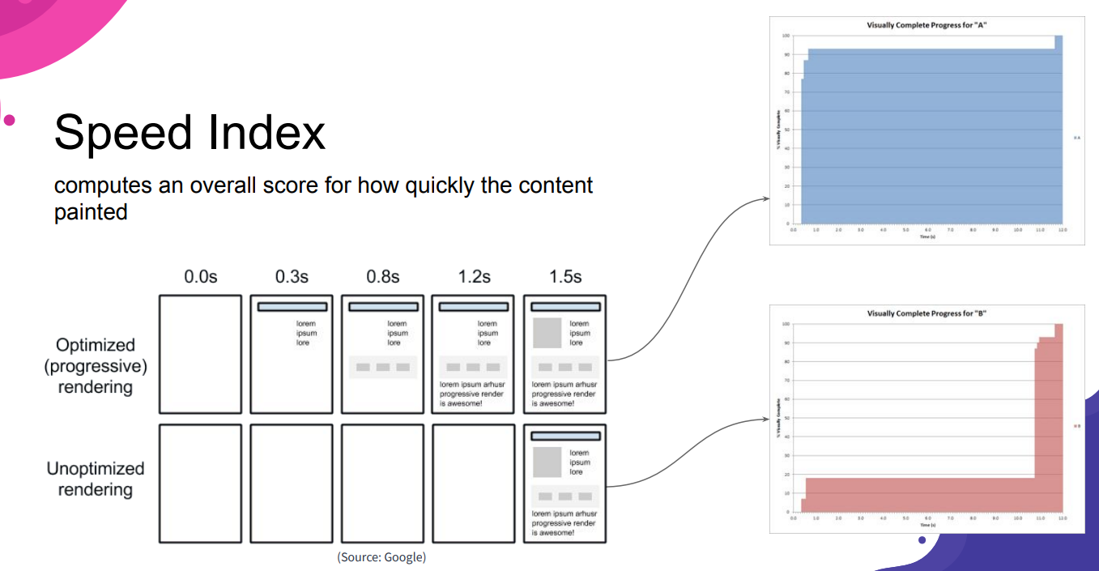
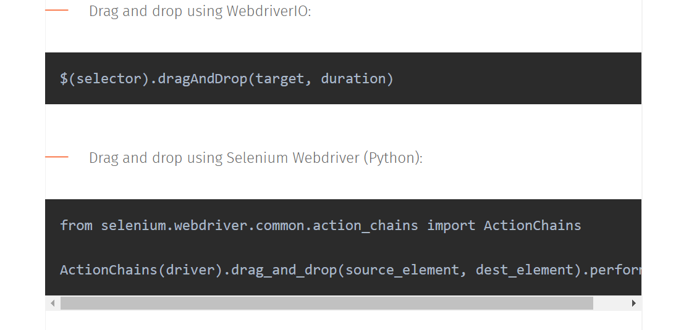
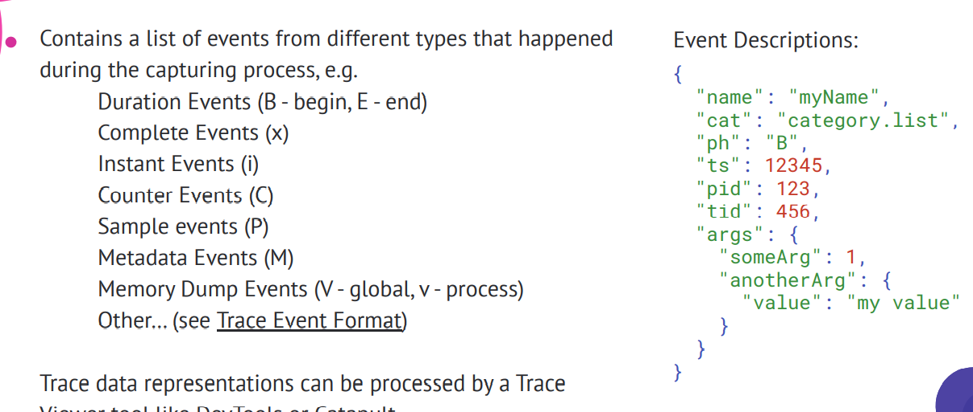
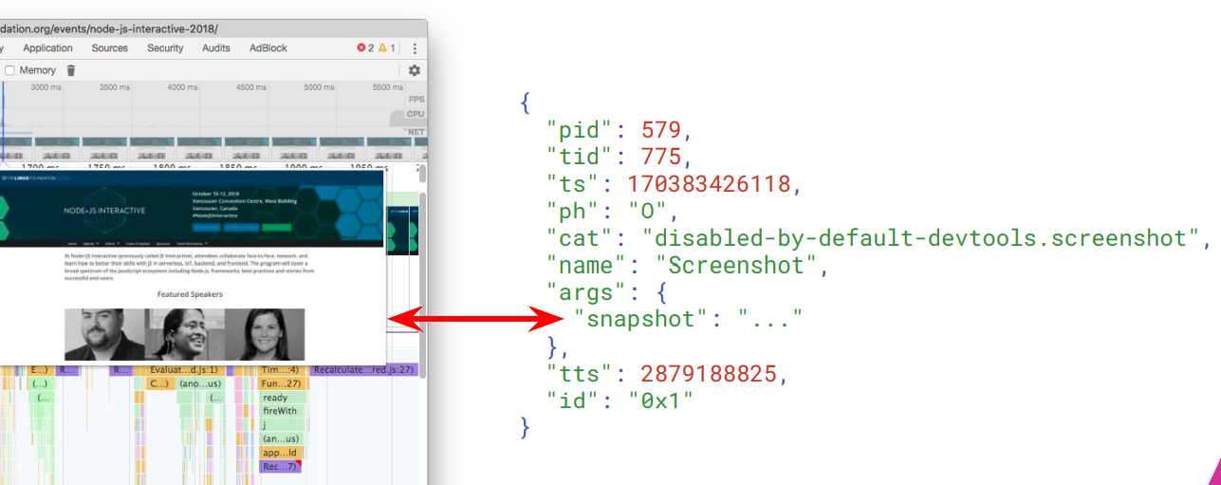
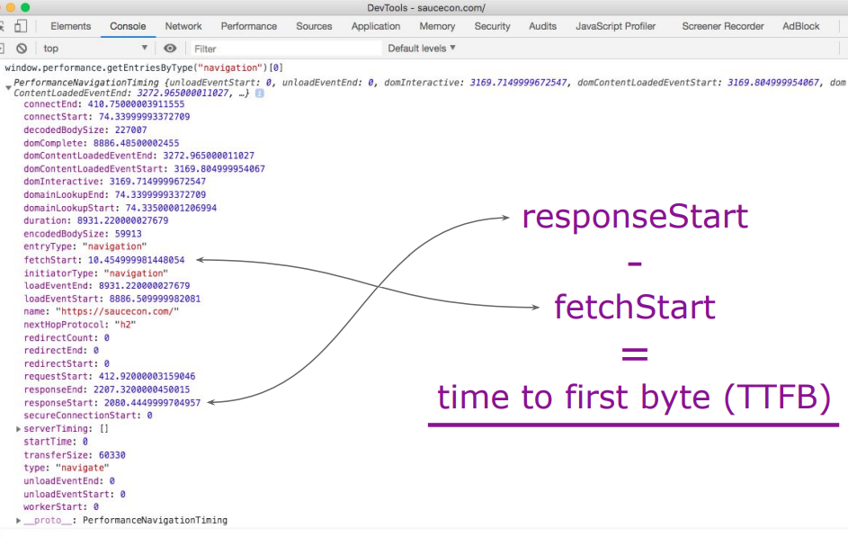
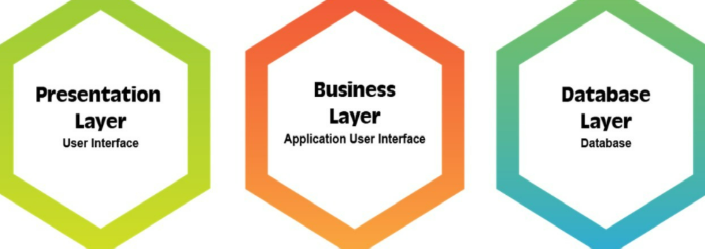
Webdriver.io Capabilities
#Recommended by W3C
#Open Source
#Parallel Testing
#Cross Browser Testing
#Easy Reports Integration
#Modern Web Frameworks
#Multiremote
#API Testing
#Easy Setup & Installation
#Smart Selectors
#Programming skills need minimized
#Jira/Xray Integration at ease
#Framework setup at ease
#Inhouse Unified JS Framework
#Desktop Automation
#Cloud Services
#Dockerization

Slide 5
Thank You
Team: Paarrivanan, Lavanya, Bala, Sravani
References:
Official Doc
WebdriverIO · Next-gen browser and mobile automation test framework for Node.js |

